Slide 1
Recursive Descent Parsing
CS 236
Fall 2023

Slide 2
Overview and Due
Topics
The stack
Recursive descent parsing versus table driven parsing (via parse table)
Each nonterminal gets a method
Code structure
Due
Homework 7 due today
Homework 8 due Monday
Homework 9a and 9b due Wednesday
Project 2 due Monday, 16 October

Slide 3
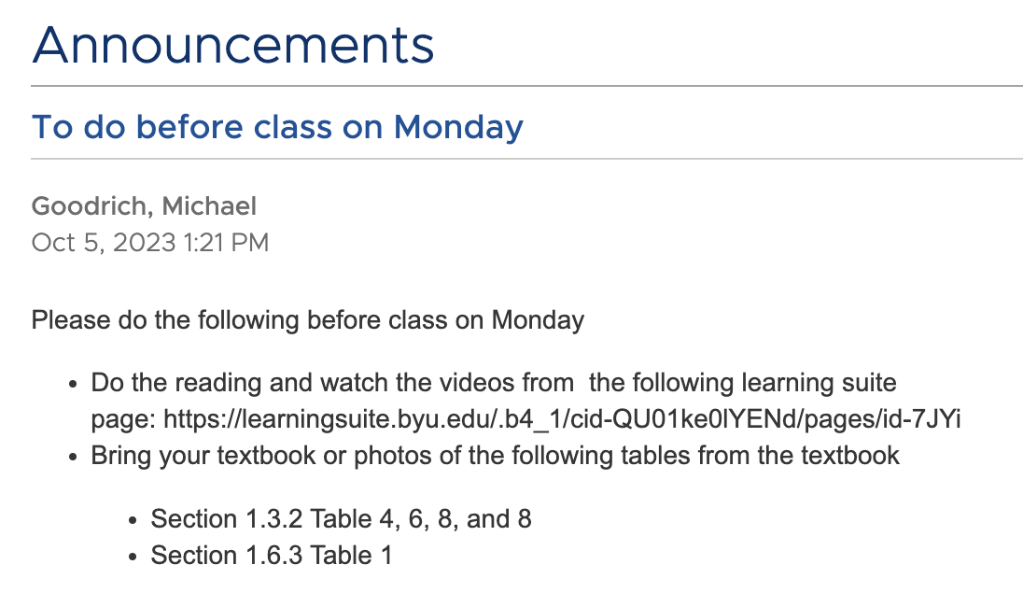
Overview and Due
Topics
The stack
Recursive descent parsing versus table driven parsing (via parse table)
Each nonterminal gets a method
Code structure
Due
Homework 7 due today
Homework 8 due Monday
Homework 9a and 9b due Wednesday
Project 2 due Monday, 16 October

Slide 4
Stack
A stack is needed to recognize context-free grammars
In table-driven parsing we had an explicit stack that kept track of where we were in the derivation
In recursive-descent parsing, the system takes care of the stack because recursion is implemented with a stack

Slide 5
Review of the Call Stack

Slide 6
Memory Organization in a Computer
High address
Your program
Low address
Operating System Stuff
Notes:
Label stack and heap

Slide 7
Memory Organization in a Computer
High address
Your program
Low address
Operating System Stuff

Slide 8
Memory Organization in a Computer
High address
Recursion uses the stack
def factorial(n: int) -> int:
if n>1:
return n * factorial(n-1)
else:
return 1
factorial(4)
Low address
Operating System Stuff

Slide 9
Memory Organization in a Computer
High address
Factorial(4)
Push
Recursion uses the stack
def factorial(n: int) -> int:
if n>1:
return n * factorial(n-1)
else:
return 1
factorial(4)
Low address
Operating System Stuff

Slide 10
Memory Organization in a Computer
High address
Factorial(4)
Factorial(3)
Push
Recursion uses the stack
def factorial(n: int) -> int:
if n>1:
return n * factorial(n-1)
else:
return 1
factorial(4)
Low address
Operating System Stuff

Slide 11
Memory Organization in a Computer
High address
Factorial(4)
Factorial(3)
Factorial(2)
Push
Recursion uses the stack
def factorial(n: int) -> int:
if n>1:
return n * factorial(n-1)
else:
return 1
factorial(4)
Low address
Operating System Stuff

Slide 12
Memory Organization in a Computer
High address
Factorial(4)
Factorial(3)
Factorial(2)
Push
Recursion uses the stack
Factorial(1)
def factorial(n: int) -> int:
if n>1:
return n * factorial(n-1)
else:
return 1
factorial(4)
Low address
Operating System Stuff

Slide 13
Memory Organization in a Computer
High address
Factorial(4)
Factorial(3)
Factorial(2)
Pop
1
Recursion uses the stack
Factorial(1)
def factorial(n: int) -> int:
if n>1:
return n * factorial(n-1)
else:
return 1
factorial(4)
Low address
Operating System Stuff

Slide 14
Memory Organization in a Computer
High address
Factorial(4)
Factorial(3)
2
Factorial(2)
Pop
Recursion uses the stack
def factorial(n: int) -> int:
if n>1:
return n * factorial(n-1)
else:
return 1
factorial(4)
Low address
Operating System Stuff

Slide 15
Memory Organization in a Computer
High address
Factorial(4)
6
Factorial(3)
Pop
Recursion uses the stack
def factorial(n: int) -> int:
if n>1:
return n * factorial(n-1)
else:
return 1
factorial(4)
Low address
Operating System Stuff

Slide 16
Memory Organization in a Computer
High address
Factorial(4)
24
Pop
Recursion uses the stack
def factorial(n: int) -> int:
if n>1:
return n * factorial(n-1)
else:
return 1
factorial(4)
Low address
Operating System Stuff

Slide 17
Recursive Descent Parsing
Recursive descent parsing keeps track of both the input stream and the stack
But recursive descent parsing uses recursion so that the operating system manages the stack for us using the call-stack

Slide 18
Managing the Stack and Input

Slide 19
Managing Stack and Input
Parse Table
Input: we manage
Stack: we manage
Recursive Descent Parsing
Input: we manage
Stack: operating system manages

Slide 20
E → N | OEE O → + | * N → 0 | 1 | 2 | 3
Input Stream T ∪{#}
 | + | * | 0 | 1 | 2 | 3 | #
E | OEE | OEE | N | N | N | N
O | + | *
N |  |  | 0 | 1 | 2 | 3
+ | AdPop
* |  | AdPop
0 |  |  | AdPop
1 |  |  |  | AdPop
2 |  |  |  |  | AdPop
3 |  |  |  |  |  | AdPop
# |  |  |  |  |  |  | accept
Stack V∪{#}

Slide 21
Recursive Descent Parsing – Key Idea
Encode each non-terminal, A, as its own method
Calling the non-terminal’s method pushes it onto the stack
Returning from the method pops the non-terminal from the stack

Slide 22
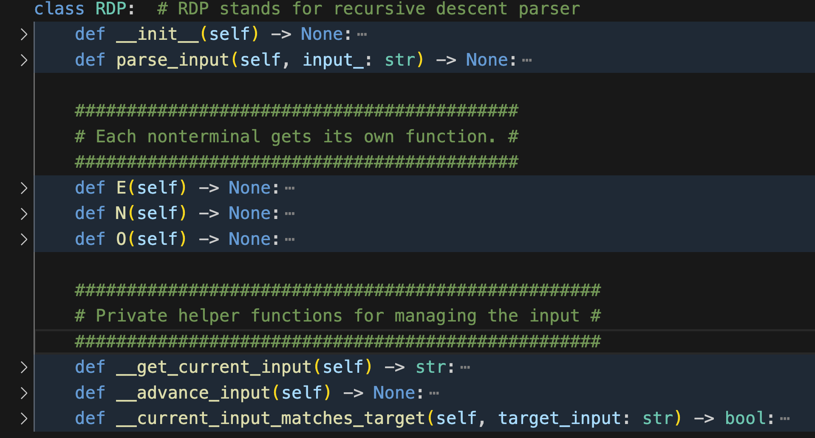
Recursive Descent Parser
E → N | OEE O → + | * N → 0 | 1 | 2 | 3
Notes:
This code is a simplified version of what is in the Jupyter notebook. Simplified to emphasize key elements

Slide 23
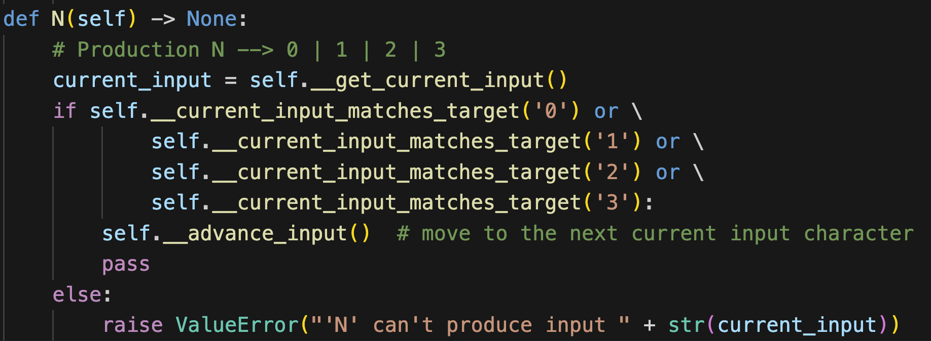
E → N | OEE O → + | * N → 0 | 1 | 2 | 3
Each non-terminal needs a method

Slide 24
E → N | OEE O → + | * N → 0 | 1 | 2 | 3
Each non-terminal needs a method

Slide 25
E → N | OEE O → + | * N → 0 | 1 | 2 | 3
Each non-terminal needs a method

Slide 26
E → N | OEE O → + | * N → 0 | 1 | 2 | 3
Each non-terminal needs a method
AdPop

Slide 27
E → N | OEE O → + | * N → 0 | 1 | 2 | 3
Each non-terminal needs a method
AdPop
Notes:
Pass versus return – pass allows the next statement to run. Return exits the function

Slide 28
E → N | OEE O → + | * N → 0 | 1 | 2 | 3
Each non-terminal needs a method
If input doesn’t match, return error
Input can’t be generated by the nonterminal

Slide 29
E → N | OEE O → + | * N → 0 | 1 | 2 | 3
Each non-terminal needs a method
Raise an error
Prompt: what does raise do in Python

Slide 30
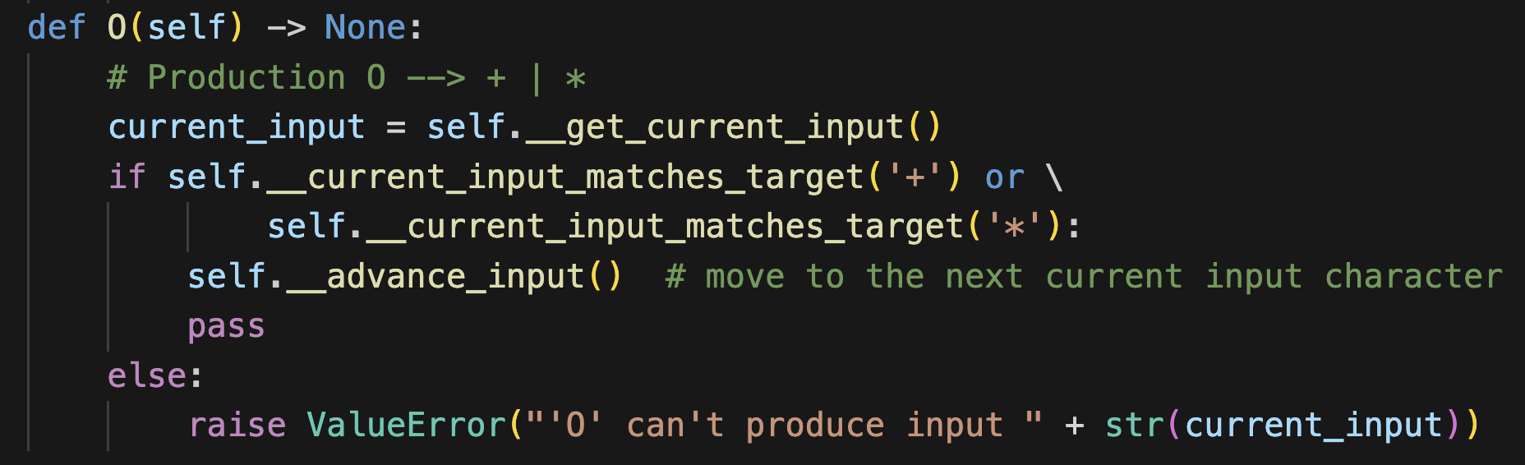
E → N | OEE O → + | * N → 0 | 1 | 2 | 3
Each non-terminal needs a method

Slide 31
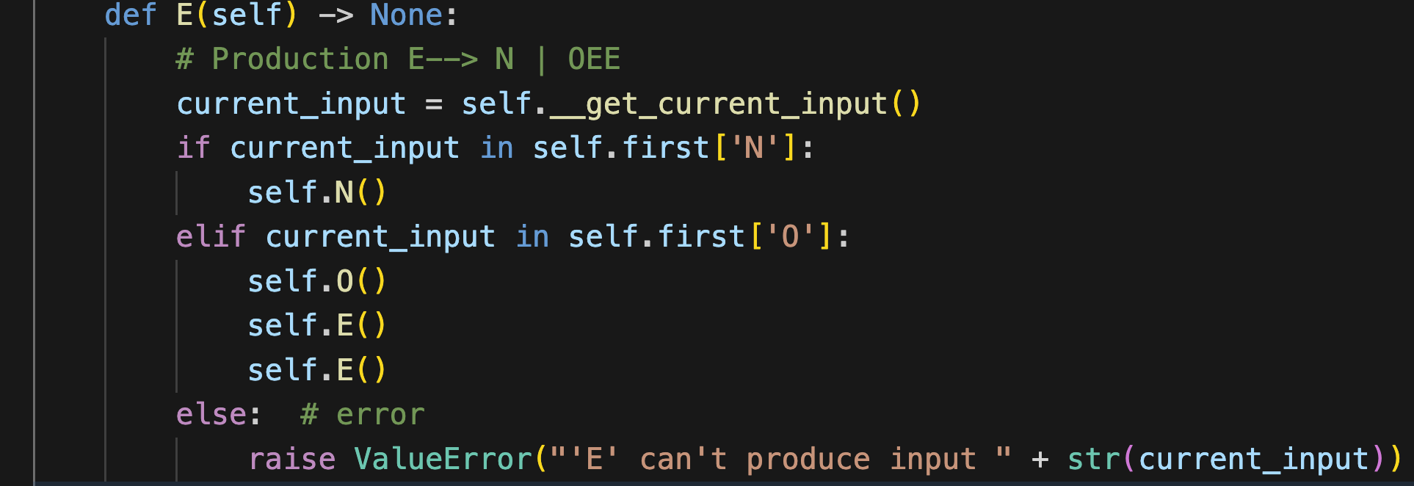
E → N | OEE O → + | * N → 0 | 1 | 2 | 3
Each non-terminal needs a method
FIRST set of N

Slide 32
E → N | OEE O → + | * N → 0 | 1 | 2 | 3
Each non-terminal needs a method
FIRST set of OEE

Slide 33
E → N | OEE O → + | * N → 0 | 1 | 2 | 3
Each non-terminal needs a method
if input is in the FIRST set of OEE then call OEE

Slide 34
E → N | OEE O → + | * N → 0 | 1 | 2 | 3
Input Stream T ∪{#}
if input is in the FIRST set of OEE then call OEE
 | + | * | 0 | 1 | 2 | 3 | #
E | OEE | OEE | N | N | N | N
O | + | *
N |  |  | 0 | 1 | 2 | 3
+ | AdPop
* |  | AdPop
0 |  |  | AdPop
1 |  |  |  | AdPop
2 |  |  |  |  | AdPop
3 |  |  |  |  |  | AdPop
# |  |  |  |  |  |  | accept
Stack V∪{#}

Slide 35
From Parse Table to Recursion

Slide 36
E → N | OEE O → + | * N → 0 | 1 | 2 | 3
Input
+*231
Call stack
main calls E(input)

Slide 37
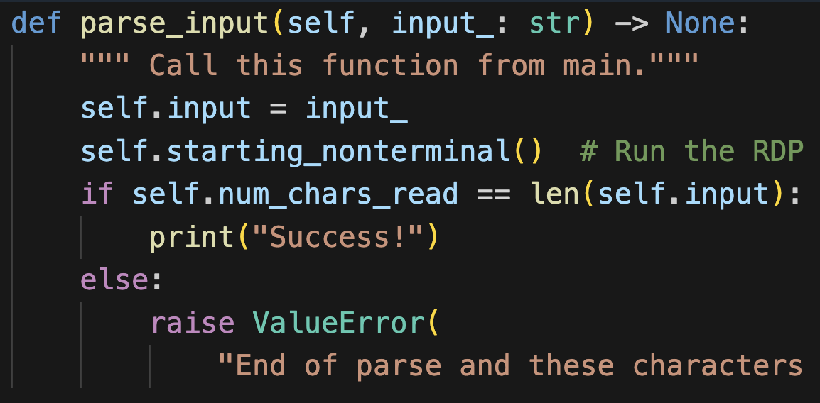
E → N | OEE O → + | * N → 0 | 1 | 2 | 3
Input
+*231
Run the RDP by
calling E
Call stack
main calls E(input)

Slide 38
E → N | OEE O → + | * N → 0 | 1 | 2 | 3
Input
+*231
Which pushes E
onto the stack
Call stack
E(input)
main calls E(input)

Slide 39
E → N | OEE O → + | * N → 0 | 1 | 2 | 3
Input
+*231
Run E
Call stack
E(input)
main calls E(input)

Slide 40
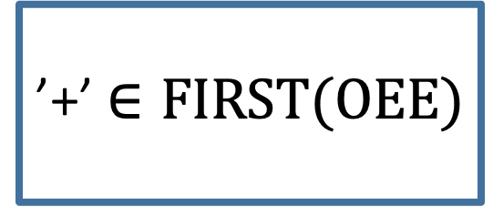
E → N | OEE O → + | * N → 0 | 1 | 2 | 3
Input
’+’ $∈FIRST(OEE)$
+*231
Call stack
E(input)
main calls E(input)

Slide 41
E → N | OEE O → + | * N → 0 | 1 | 2 | 3
Input
’+’ $∈FIRST(OEE)$
+*231
Call stack
E(input)
 | + | * | 0 | 1 | 2 | 3 | #
E | OEE | OEE | N | N | N | N
O | + | *
N |  |  | 0 | 1 | 2 | 3
+ | AdPop
* |  | AdPop
0 |  |  | AdPop
1 |  |  |  | AdPop
2 |  |  |  |  | AdPop
3 |  |  |  |  |  | AdPop
# |  |  |  |  |  |  | accept
main calls E(input)

Slide 42
E → N | OEE O → + | * N → 0 | 1 | 2 | 3
Input
Call O
Which pushes O to the stack
+*231
Call stack
E(input)
O(input)
main calls E(input)

Slide 43
E → N | OEE O → + | * N → 0 | 1 | 2 | 3
Input
Run O
+*231
Call stack
E(input)
O(input)
main calls E(input)

Slide 44
E → N | OEE O → + | * N → 0 | 1 | 2 | 3
Input
Match
+*231
Call stack
E(input)
O(input)
main calls E(input)

Slide 45
E → N | OEE O → + | * N → 0 | 1 | 2 | 3
Input
Push +
+*231
Call stack
E(input)
 | + | * | 0 | 1 | 2 | 3 | #
E | OEE | OEE | N | N | N | N
O | + | *
N |  |  | 0 | 1 | 2 | 3
+ | AdPop
* |  | AdPop
0 |  |  | AdPop
1 |  |  |  | AdPop
2 |  |  |  |  | AdPop
3 |  |  |  |  |  | AdPop
# |  |  |  |  |  |  | accept
O(input)
main calls E(input)

Slide 46
E → N | OEE O → + | * N → 0 | 1 | 2 | 3
Input
Immediately after pop +
+*231
Call stack
E(input)
 | + | * | 0 | 1 | 2 | 3 | #
E | OEE | OEE | N | N | N | N
O | + | *
N |  |  | 0 | 1 | 2 | 3
+ | AdPop
* |  | AdPop
0 |  |  | AdPop
1 |  |  |  | AdPop
2 |  |  |  |  | AdPop
3 |  |  |  |  |  | AdPop
# |  |  |  |  |  |  | accept
O(input)
main calls E(input)

Slide 47
E → N | OEE O → + | * N → 0 | 1 | 2 | 3
Input
AdPop
+*231
Call stack
E(input)
O(input)
main calls E(input)

Slide 48
E → N | OEE O → + | * N → 0 | 1 | 2 | 3
Input
AdPop
+*231
Call stack
E(input)
O(input)
main calls E(input)

Slide 49
E → N | OEE O → + | * N → 0 | 1 | 2 | 3
Input
AdPop
+*231
Call stack
E(input)
O(input)
main calls E(input)

Slide 50
E → N | OEE O → + | * N → 0 | 1 | 2 | 3
Input
AdPop
+*231
Call stack
E(input)
main calls E(input)

Slide 51
E → N | OEE O → + | * N → 0 | 1 | 2 | 3
Input
Return to E
+*231
Call stack
E(input)
main calls E(input)

Slide 52
E → N | OEE O → + | * N → 0 | 1 | 2 | 3
Input
We already ran O
+*231
Call stack
E(input)
main calls E(input)

Slide 53
E → N | OEE O → + | * N → 0 | 1 | 2 | 3
Input
call the next E
+*231
Call stack
E(input)
main calls E(input)

Slide 54
E → N | OEE O → + | * N → 0 | 1 | 2 | 3
Input
which pushes E onto the stack
+*231
Call stack
E(input)
E(input)
main calls E(input)

Slide 55
E → N | OEE O → + | * N → 0 | 1 | 2 | 3
Input
In new copy of the E
+*231
Call stack
E(input)
E(input)
main calls E(input)

Slide 56
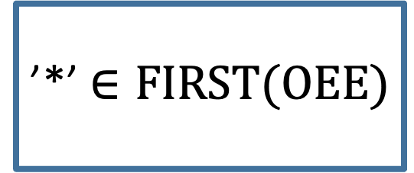
E → N | OEE O → + | * N → 0 | 1 | 2 | 3
Input
’*’ $∈FIRST(OEE)$
+*231
Call stack
E(input)
E(input)
main calls E(input)

Slide 57
E → N | OEE O → + | * N → 0 | 1 | 2 | 3
Input
Run O
+*231
Call stack
E(input)
E(input)
O(input)
main calls E(input)

Slide 58
E → N | OEE O → + | * N → 0 | 1 | 2 | 3
Input
Match *
+*231
Call stack
E(input)
E(input)
O(input)
main calls E(input)

Slide 59
E → N | OEE O → + | * N → 0 | 1 | 2 | 3
Input
AdPop
+*231
Call stack
E(input)
E(input)
O(input)
main calls E(input)

Slide 60
E → N | OEE O → + | * N → 0 | 1 | 2 | 3
Input
AdPop
+*231
Call stack
E(input)
E(input)
main calls E(input)

Slide 61
E → N | OEE O → + | * N → 0 | 1 | 2 | 3
Input
Return to E
Call next E
+*231
Call stack
E(input)
E(input)
E(input)
main calls E(input)

Slide 62
Application to Project 2

Slide 63
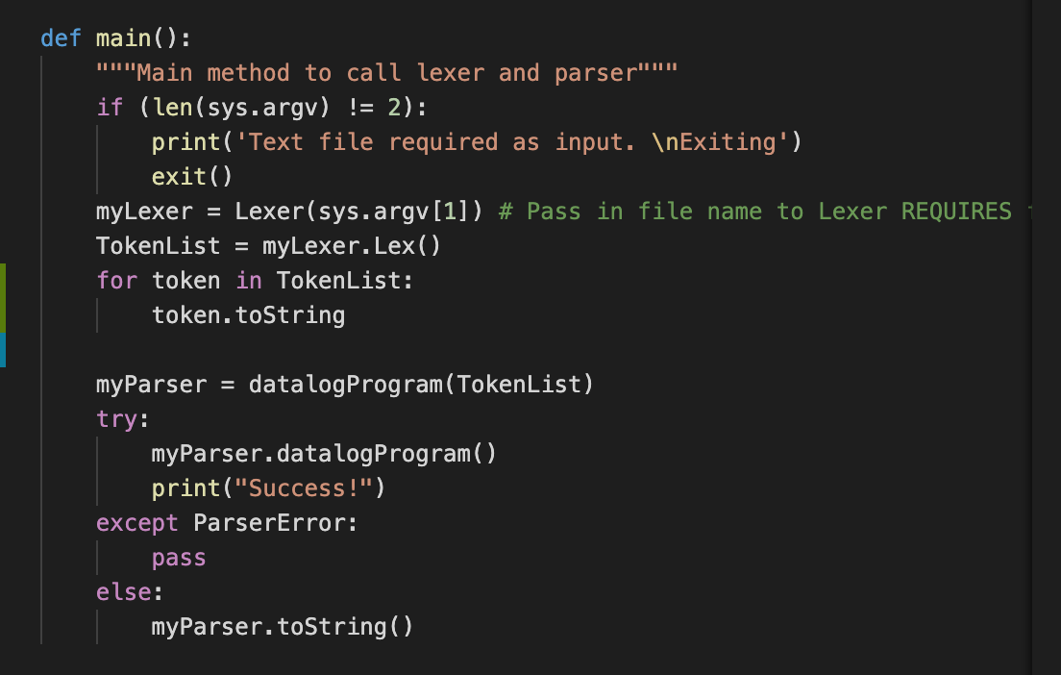
Main

Slide 64
Main

Slide 65
Main
Prompt: what do try and except do in Python

Slide 66
Datalog Grammar (partial), from https://learningsuite.byu.edu/.Z3FE/cid-I4ezssz0M_oT/pages/id-ssbw
datalogProgram -> SCHEMES COLON scheme schemeList FACTS COLON factList RULES COLON ruleList QUERIES COLON query queryList
schemeList -> scheme schemeList | lambda
factList -> fact factList | lambda
ruleList -> rule ruleList | lambda
queryList -> query queryList | lambda
scheme -> ID LEFT_PAREN ID idList RIGHT_PAREN
fact -> ID LEFT_PAREN STRING stringList RIGHT_PAREN PERIOD
rule -> headPredicate COLON_DASH predicate predicateList PERIOD
query -> predicate Q_MARK
…

Slide 67
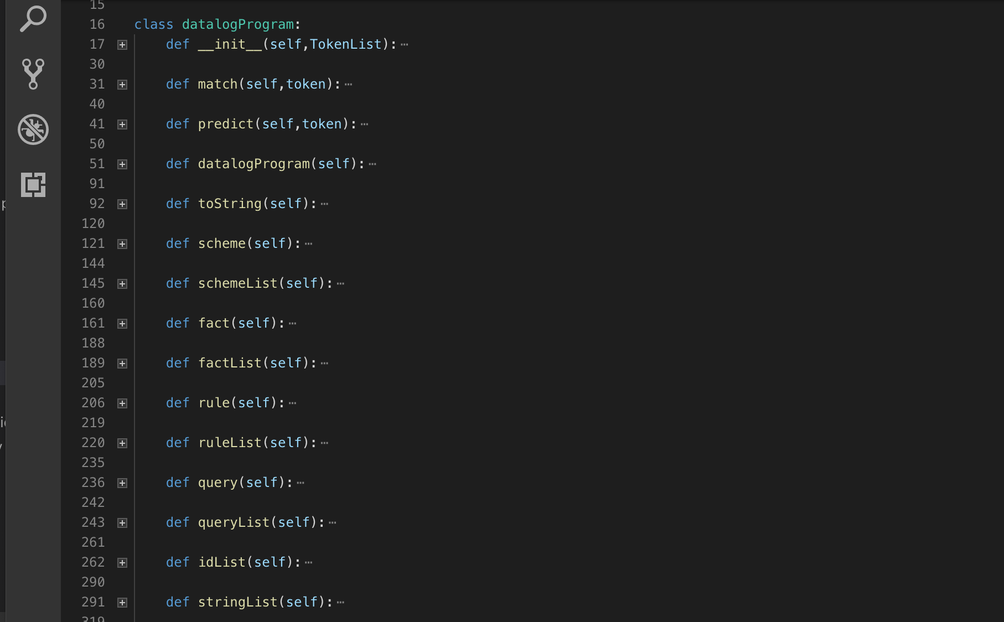
My Python Parser

Slide 68
My Python Parser
datalogProgram -> SCHEMES COLON scheme schemeList FACTS COLON factList RULES COLON ruleList QUERIES COLON query queryList
schemeList -> scheme schemeList | lambda
factList -> fact factList | lambda
ruleList -> rule ruleList | lambda
queryList -> query queryList | lambda
scheme -> ID LEFT_PAREN ID idList RIGHT_PAREN
fact -> ID LEFT_PAREN STRING stringList RIGHT_PAREN PERIOD
rule -> headPredicate COLON_DASH predicate predicateList PERIOD
query -> predicate Q_MARK
…

Slide 69
My Python Parser
Each non-terminal has a method
datalogProgram -> SCHEMES COLON scheme schemeList FACTS COLON factList RULES COLON ruleList QUERIES COLON query queryList
schemeList -> scheme schemeList | lambda
factList -> fact factList | lambda
ruleList -> rule ruleList | lambda
queryList -> query queryList | lambda
scheme -> ID LEFT_PAREN ID idList RIGHT_PAREN
fact -> ID LEFT_PAREN STRING stringList RIGHT_PAREN PERIOD
rule -> headPredicate COLON_DASH predicate predicateList PERIOD
query -> predicate Q_MARK
…

Slide 70
My Python Parser
Each non-terminal has a method
datalogProgram -> SCHEMES COLON scheme schemeList FACTS COLON factList RULES COLON ruleList QUERIES COLON query queryList
schemeList -> scheme schemeList | lambda
factList -> fact factList | lambda
ruleList -> rule ruleList | lambda
queryList -> query queryList | lambda
scheme -> ID LEFT_PAREN ID idList RIGHT_PAREN
fact -> ID LEFT_PAREN STRING stringList RIGHT_PAREN PERIOD
rule -> headPredicate COLON_DASH predicate predicateList PERIOD
query -> predicate Q_MARK
…

Slide 71
A Complete Datalog Program
Schemes:
A(C)
Facts:
Rules:
Queries:
A(b1)?

Slide 72
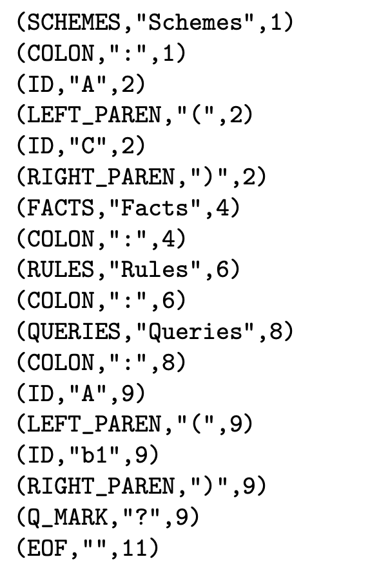
A Complete Datalog Program
Schemes:
A(C)
Facts:
Rules:
Queries:
A(b1)?
This is the input to the parser

Slide 73
Trace
Stack
Input
Datalog()

Slide 74
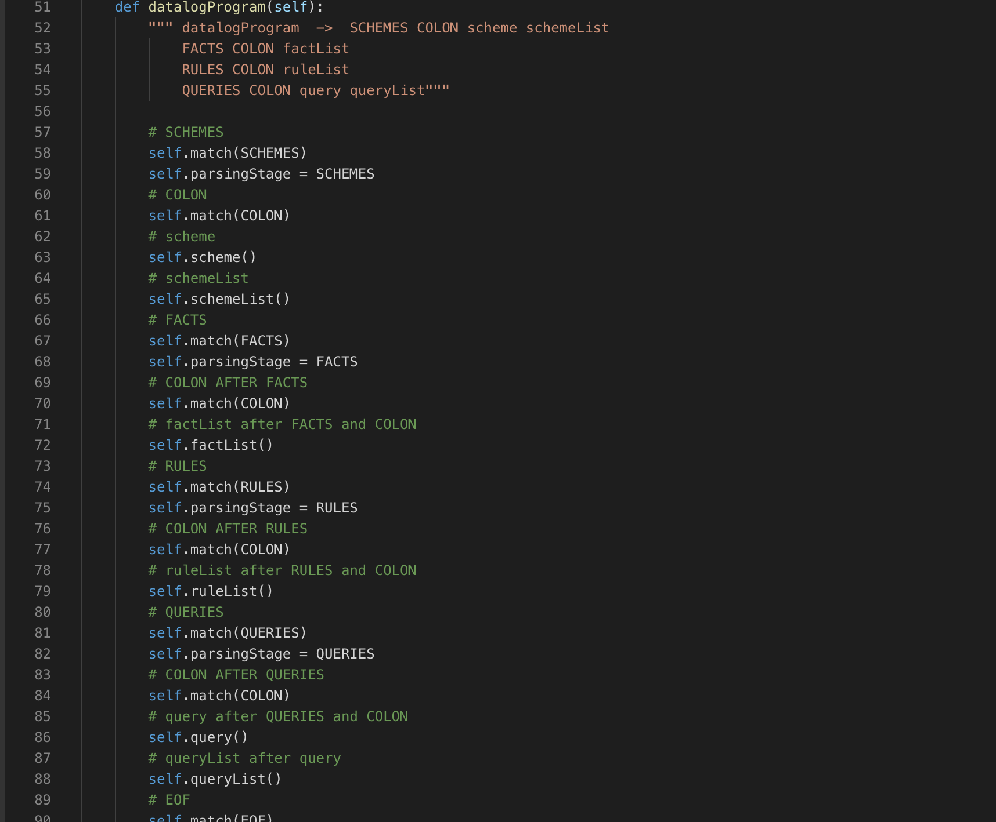
Trace
Stack
Input
Datalog()

Slide 75
Trace
Stack
Input
Datalog()

Slide 76
Trace
Stack
Input
Datalog()

Slide 77
Trace
Stack
Input
Datalog()

Slide 78
Trace
Stack
Input
Datalog()
scheme()

Slide 79
Trace
Stack
Input
Datalog()
scheme()
Skipping what
happens in
scheme

Slide 80
Trace
Stack
Input
Datalog()
scheme()
Skipping what
happens in
scheme

Slide 81
Trace
Stack
Input
Datalog()
Skipping what
happens in
scheme

Slide 82
Trace
Stack
Input
Datalog()

Slide 83
Trace
Stack
Input
Datalog()
schemeList()

Slide 84
Interlude: What about FOLLOW Sets?

Slide 85
new grammar E → nDI | OEE I → DI | λ O → + | * D → 0 | 1 | 2 | 3
New grammar:
Allow two digit arithmetic
+n12n100
Notes:
Jupyter notebook on recursive descent parsing with FOLLOW sets

Slide 86
new grammar E → nDI | OEE I → DI | λ O → + | * D → 0 | 1 | 2 | 3
New grammar:
Allow two digit arithmetic
old grammar
E → N | OEE O → + | * N → 0 | 1 | 2 | 3

Slide 87
new grammar E → nDI | OEE I → DI | λ O → + | * D → 0 | 1 | 2 | 3
FIRST sets of right hand side of productions
FIRST(nDI) = {n}
FIRST(OEE) = {+,*}
FIRST(DI) = {0,1,2,3}
Notes:
Jupyter notebook on recursive descent parsing with FOLLOW sets

Slide 88
new grammar E → nDI | OEE I → DI | λ O → + | * D → 0 | 1 | 2 | 3
New grammar:
FOLLOW sets of non-terminals
tail recursion requires follow sets
Notes:
Jupyter notebook on recursive descent parsing with FOLLOW sets

Slide 89
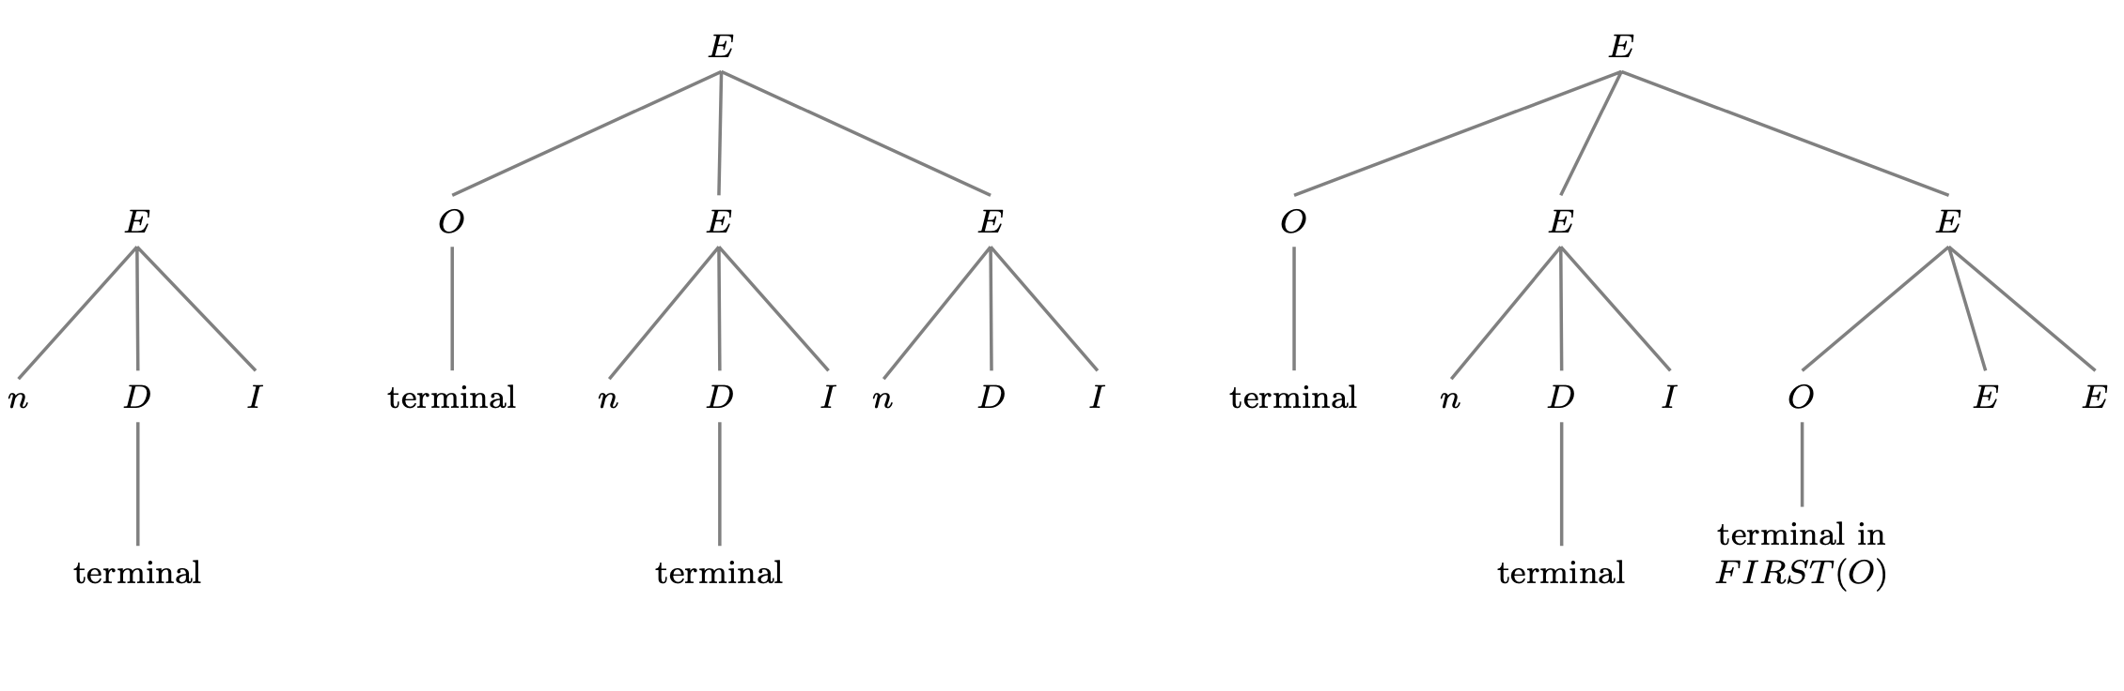
new grammar E → nDI | OEE I → DI | λ O → + | * D → 0 | 1 | 2 | 3
New grammar:
FOLLOW sets of non-terminals
FOLLOW(I) = {#,n,+,*}
where # is end of string character
Notes:
Jupyter notebook on recursive descent parsing with FOLLOW sets

Slide 90
new grammar E → nDI | OEE I → DI | λ O → + | * D → 0 | 1 | 2 | 3
New grammar:
FOLLOW sets of non-terminals
FOLLOW(I) = {#,n,+,*}
where # is end of string character
Notes:
Jupyter notebook on recursive descent parsing with FOLLOW sets

Slide 91
new grammar E → nDI | OEE I → DI | λ O → + | * D → 0 | 1 | 2 | 3
New grammar:
FOLLOW sets of non-terminals
FOLLOW(I) = {#,n,+,*}
where # is end of string character
Notes:
Jupyter notebook on recursive descent parsing with FOLLOW sets

Slide 92
new grammar E → nDI | OEE I → DI | λ O → + | * D → 0 | 1 | 2 | 3
New grammar:
FOLLOW sets of non-terminals
FOLLOW(I) = {#,n,+,*}
where # is end of string character
Notes:
Jupyter notebook on recursive descent parsing with FOLLOW sets

Slide 93
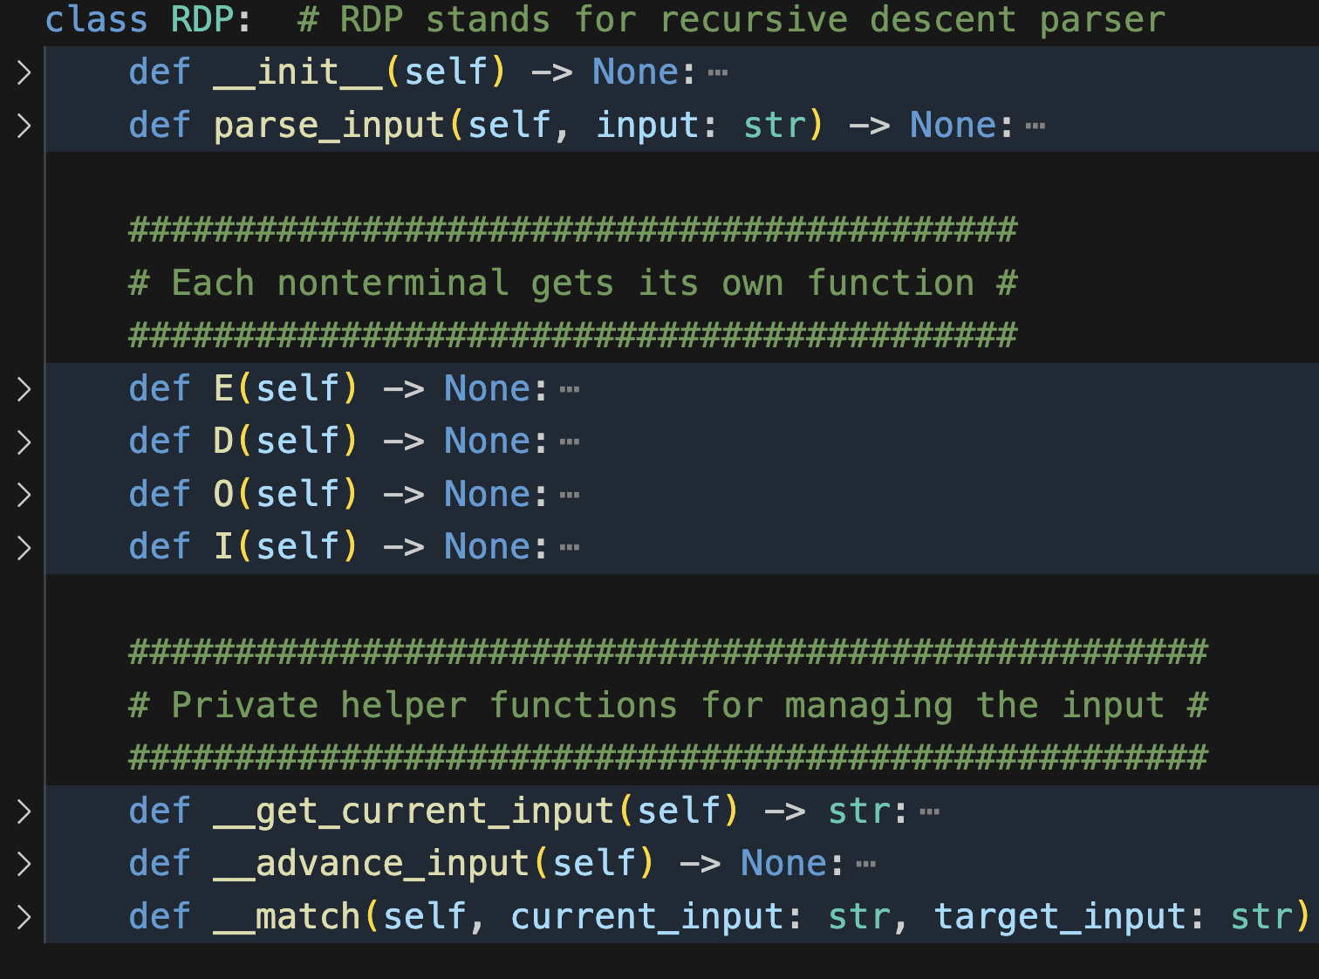
new grammar E → nDI | OEE I → DI | λ O → + | * D → 0 | 1 | 2 | 3
Recursive descent parser for new grammar
FIRST(nDI) = {n}
FIRST(OEE) = {+,*}
FIRST(DI) = {0,1,2,3}
FOLLOW(I) = {#,n,+,*}
Notes:
Jupyter notebook on recursive descent parsing with FOLLOW sets

Slide 94
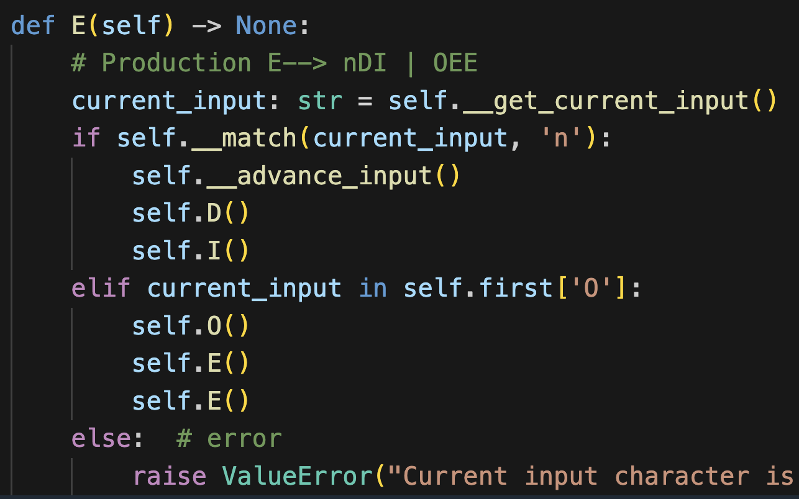
E → nDI | OEE I → DI | λ O → + | * D → 0 | 1 | 2 | 3
FIRST(nDI) = {n}
FIRST(OEE) = {+,*}

Slide 95
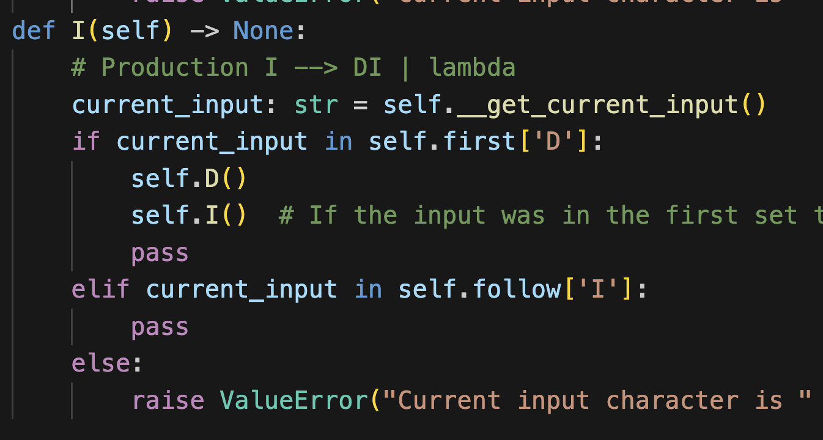
E → nDI | OEE I → DI | λ O → + | * D → 0 | 1 | 2 | 3
FIRST(DI) = {0,1,2,3}
FOLLOW(I) = {#,n,+,*}

Slide 96
E → nDI | OEE I → DI | λ O → + | * D → 0 | 1 | 2 | 3
FIRST(DI) = {0,1,2,3}
FOLLOW(I) = {#,n,+,*}

Slide 97
E → nDI | OEE I → DI | λ O → + | * D → 0 | 1 | 2 | 3
FIRST(DI) = {0,1,2,3}
FOLLOW(I) = {#,n,+,*}

Slide 98
Returning to Project 2 Example

Slide 99
Trace
Stack
Input
Datalog()
schemeList()
FACTS ∈ FOLLOW(schemeList)
Use lambda production

Slide 100
Trace
Stack
Input
Datalog()
FACTS ∈ FOLLOW(schemeList)
Use lambda production

Slide 101
Trace
Stack
Input
Datalog()

Slide 102
Trace
Stack
Input
Datalog()

Slide 103
Trace
Stack
Input
Datalog()
factList()

Slide 104
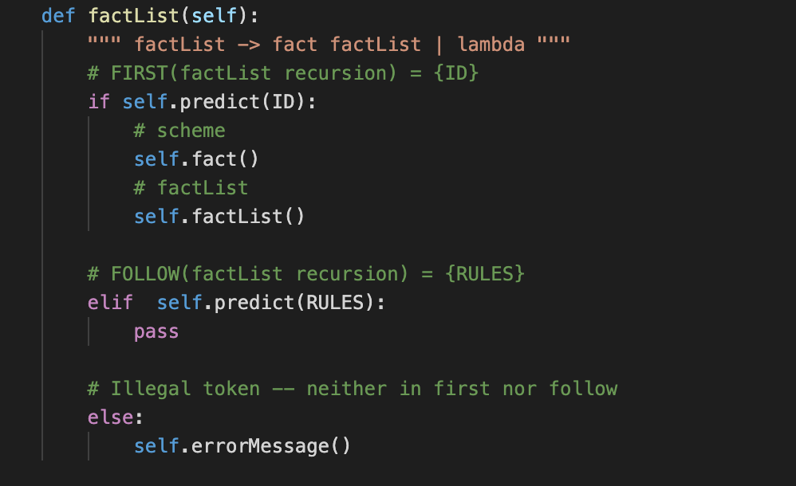
Trace
Stack
Input
Datalog()
factList()

Slide 105
Trace
Stack
Input
Datalog()
factList()
RULES ∈ FOLLOW(factList)
Use lambda production

Slide 106
Trace
Stack
Input
Datalog()

Slide 107
Trace
Stack
Input
Datalog()

